Slide 1


Slide 2



Lecture 6
End of year adjustments II: Accruals & Prepayments,
Bad Debts &
Provision for Doubtful Debt

Slide 3
Learning Outcomes:
Upon successful completion of the session student will be able to:
1. Recognize how the matching concept applies to accruals and prepayments;
2.Prepare the journal entries and ledger entries for the creation of an accrual or prepayment;
3. Understand the definition of 'provision;
4. Calculate provisions and changes in provisions;
5. Report provisions in the final accounts.

Slide 4
End of Year Adjustments
RECAP
The Basics of Adjusting Entries
How it effects the Financial Statements
Fiscal and calendar years
Periodicity concept
Applying revenue & matching principle
Adjusting entries for accruals
Adjusting entries for prepayments
Entries for bad debts and provision for doubtful debts
Summary of journalizing and posting
Where to put the items in the financial statements

Slide 5
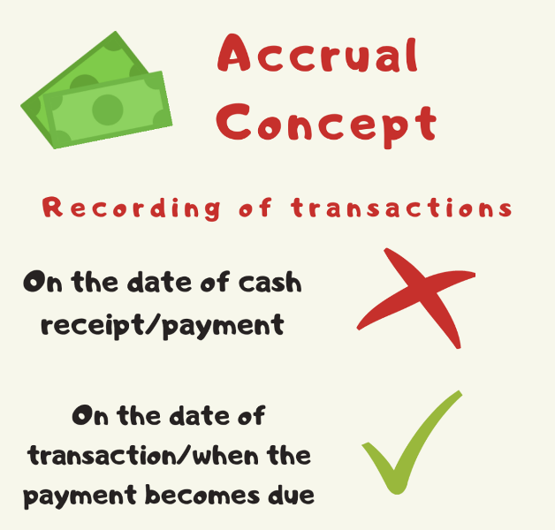
Measurement Rules
Accrual basis – revenue or expenditure is realized at the point of sale or purchase which may not be similar to the receipt or disbursement of cash. The accrual basis of accounting recognizes revenue in the period in which they are earned and in the same period deducts the expenses incurred in generating those revenues.

Slide 6
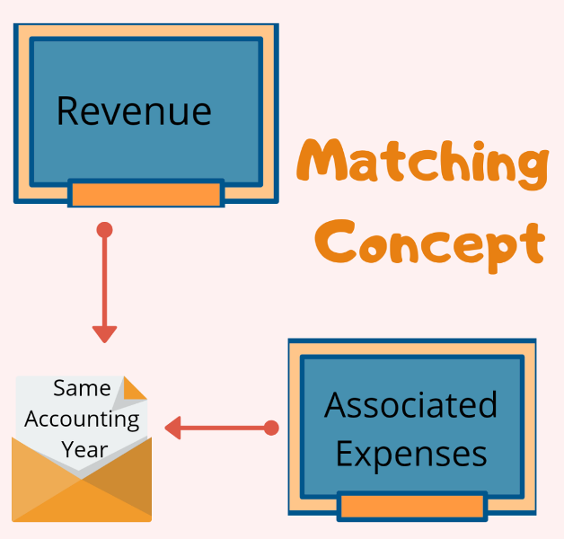
Measurement Rules
3. Matching – the revenue earned in one period should be matched only with relevant expenses incurred in generating the revenue during the same period to enable a fair calculation of the profit or loss for the period.

Slide 7
Adjusting Entries
Adjusting entries make it possible to report correct amounts on the balance sheet and on the income statement.
A company must make adjusting entries every time it prepares financial statements.
Revenues - recorded in the period in which they are earned.
Expenses - recognized in the period in which they are incurred.
Adjusting entries - needed to ensure that the revenue recognition and matching principles are followed.

Slide 8
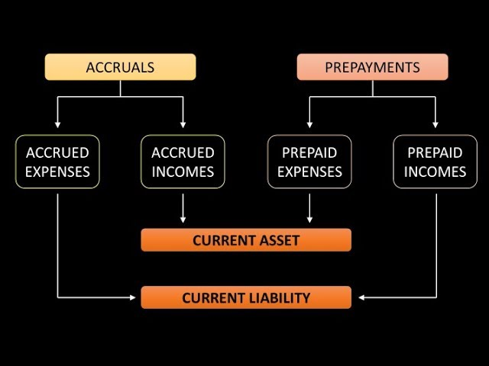
Accruals and prepayments

Slide 9
Accruals and prepayments
Arise from four types of implicit transactions:
Expiration or consumption of unexpired costs-Prepaid expenses
Earning of revenues received in advance-Prepaid (deferred) revenues
Accrual of unrecorded expenses -Accrued expenses
Accrual of unrecorded revenues-Accrued revenues

Slide 10
Prepaid expenses
Prepaid expenses represent expenditures that have not yet been recorded by a company as an expense, but have been paid for in advance.
In other words, prepaid expenses are expenditures paid in one accounting period, but will not be recognized until a later accounting period.
Prepaid expenses are initially recorded as assets, because they have future economic benefits, and are expensed at the time when the benefits are realized (the matching principle).

Slide 11
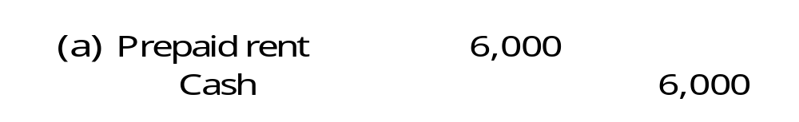
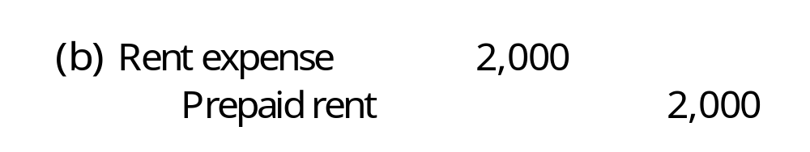
Prepaid expenses
A company pays $6,000 rent in advance for the months of January, February, and March
  Transaction initially recorded as an asset
  End of January, asset declines in value as rent for one month has been consumed

Slide 12
Prepaid revenue
  Cash received from customers who pay in advance for goods or services to be delivered at a future date
  Also known as revenue received in advance or deferred revenue
  Requires recording both the receipt of cash and the liability for future goods or services

Slide 13
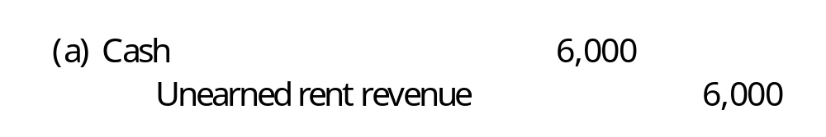
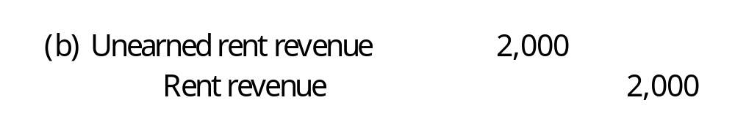
Prepaid revenue
A company receives $6,000 in cash for rent in advance for the months of January, February, and March
  Transaction initially recorded as a liability
  End of January, liability decreases as revenue for one month has been earned

Slide 14
Important in accrual accounting
1.Accrue: To accumulate a receivable (asset) or payable (liability) during a given period, even though no explicit transaction occurs, and to record a corresponding revenue or expense
2.Accruals are not based on explicit transactions, hence not recorded on a day-to-day basis
3.Affect both an income statement account and a balance sheet account
4. Never affect cash
5.Help match revenues and expenses to appropriate accounting period
6.Ensure that balance sheet correctly states assets and liabilities

Slide 15
Accrual of Unrecorded Expenses
Accrued expense is a concept in accrual accounting that refers to the type of expenses that are recognized when incurred but not yet paid.
In some transactions, cash is not paid or earned yet when the revenues or expenses are incurred. For example, a company pays its February utility bill in March, or delivers its products to customers in May and receives the payment in June. Accrual accounting requires revenues and expenses to be recorded in the accounting period that they are incurred.

Slide 16
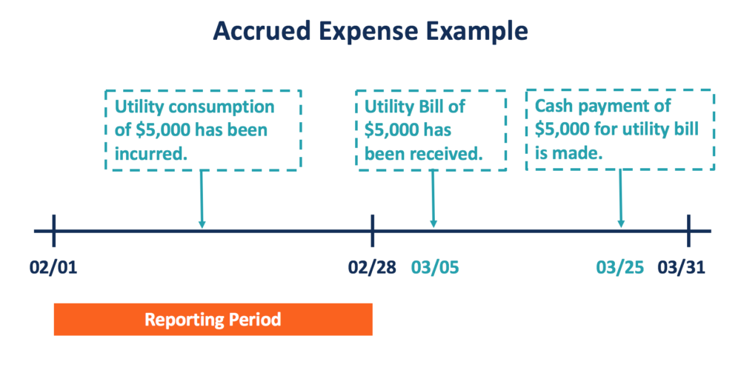
Accrual of Unrecorded Expenses
Date | General Journal | Debit | Credit
Feb 28 | Utility Expense | $ 5 000
 | Utility payable |  | $ 5 000

Slide 17
In the reporting period of March, the company should record its cash payment on March 25 for its utility bill. This entry includes a counter account for the utility payable from the previous period and a cash account.
Date | General Journal | Debit | Credit
March 25 | Utility payable | $ 5 000
 | Cash |  | $ 5 000

Slide 18
Accruals of Unrecorded Revenues
Accrued revenue is revenue that has been earned by providing goods or services but for which no payment has been received yet.
In other words, it indicates a payment that should be received after the goods and services it refers to have been provided.

Slide 19
Accruals of Unrecorded Revenues
Suppose the bank made a $100,000 loan to a customer on December 31, 2018. The terms of the loan require repayment of the loan amount of $100,000 plus 6% interest on December 31, 2019

Slide 20
Accruals of Unrecorded Revenues
As of January 31, 2019, the bank has earned interest for one month
  The amount of interest earned is (1/12 x .06 x $100,000) = $500
  Adjusting entry need to accrue $500 in interest revenue earned, but not yet received, for the month of January
Date | General Journal | Debit | Credit
January 31 | Accrued interest receivable | $ 500
 | Interest revenue |  | $ 500

Slide 21
Prepayments
Prepaid expenses
Dr Prepayment (Current Assets)
Cr Bank or Cash (Current Assets)
Prepaid revenue
Dr Bank or Cash (Current Assets)
Cr Unearned revenue ( Liabilities)

Slide 22
Accruals
Accrued revenue
Dr Accrued revenue (Accounts receivable- Current Assets)
Cr Revenue(Sales, Interest, etc.)-Revenue account
Accrued expenses
Dr Expenses ( Expenses accounts)
Cr Accrued expenses ( Liabilities)

Slide 23
Bad & doubtful debts
Realization rule requires to include amount of credit sales in Revenue account even if the cash is not received at that date.
Some of debtors might default on payments when they become due.
By eliminating bad debt and creating a provision for other uncertainties, “accounting profit” is adjusted and becomes more reliable.

Slide 24
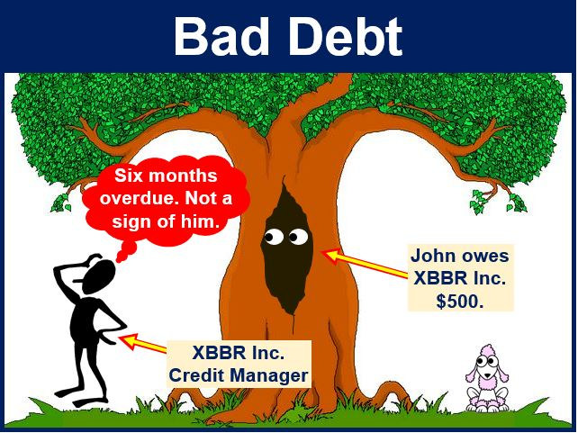
Bad & doubtful debts
Bad debt – highly unlikely it will be paid/recovered; long-time owing and proven to be bad.

Slide 25
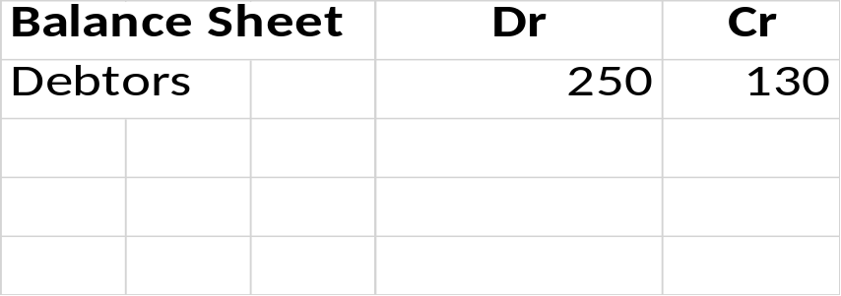
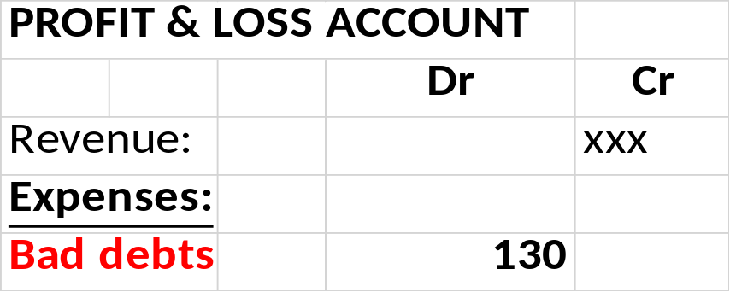
Bad & doubtful debts
On 5 January, we sold $200 and $50 of pens to Chumi and Chiki respectively. However, at the year end, Chumi only managed to pay $120 and Chiki business already went bankrupt.
Writing off a bad debt completely removes the debt from the accounting books
And the double entry will be:
Dr Bad debts (it is an expense account)
Cr Debtors (reduce the debtor figure by the amount of the bad debt)
The balance of Bad Debts account is then transferred to Profit and Loss account at the end of accounting period.

Slide 26
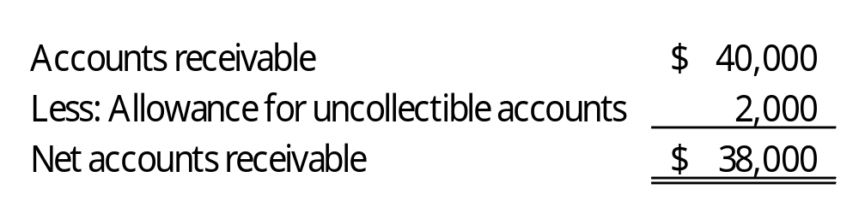
Provision for d. debts
Doubtful debts – are the debt that are likely to be bad but have not yet been proven to be so.
Represented in balance sheet as:
How do you decide how much to provide?
The estimated figure can be made:
By looking at each debt, and deciding to what extent it will be bad;
By estimating, on the basis of experience, what percentages(%) of the total amount due from the remaining debtors will ultimately prove to be bad debts.

Slide 27
Provision for d. debts
Ageing Schedule for Doubtful Debts
Period debt owing | Amount ($) | Estimated % doubtful | Provision for doubtful debts ($)
Less than 1 mth | 5,000 | 1 | 50
1 – 2 months | 3,000 | 3 | 90
2 – 3 months | 800 | 4 | 32
3 months – 1 year | 200 | 5 | 10
Over 1 year | 160 | 20 | 32
 | 9,160 |  | 214
On 31 December 2019 (year in which provision is first made), debtors amounted to $10,000 and provision for bad and doubtful debts is 2% or $200.
The accounting entries would be as follows:
Dr Bad debts $200
Cr Provision for bad and doubtful debts $200

Slide 28
Provision for d. debts
New account which is contra-account to the debtors account, thus the rules of debit and credit for this account should be the opposite to the debtors account.
If there is an increase in the provision, a credit entry should be made; a decrease in the provision will require a debit entry.
Once original (first) entries have been made, subsequent entries in the provision for bad and doubtful debts account will only be made for the additional or the reduced amounts of the provision.

Slide 29
Lecture Roundup:
1.Accrued expenses (accruals) are expenses which relate to an accounting period but have not yet been
paid for. They are shown in the statement of financial position as a liability.
2. Prepaid expenses (prepayments) are expenses which have already been paid but relate to a future
accounting period. They are shown in the statement of financial position as an asset
3. A provision should be recognised:
– When an entity has a present obligation
– When it is probable that a transfer of economic benefits will be required to settle it
– When a reliable estimate can be made of its amount


Slide 30
References:
Wood, F & Sangster, A (2001) Business Accounting 1, chapters 5, 6, 25, 26, 28
Dyson, J.R (2004) Accounting for Non-Accounting Students, chapter 5.
ACCA (2017) Approved text for the professional qualification, Study Text 2017, Paper 1. INT,Kaplan publishing: Foulks Lynch, chapter 5.
Glautier, M & Underdown B (2001) Accounting Theory and Practice, 7th edition, chapters 9 & 10.
ACCA (2017) Approved Interactive Text. Foundations in Accountancy FFA 2017/2018. BPP Media Ltd.

